Slide 1
Study Time Calculator
Hadassa Franklin (VC1A) – Dassiefranklin@gmail.com
Evie Barth (VC1B) - eviebarth18@gmail.com
Supervisor - Professor Katherine Chuang - chuang@sci.brooklyn.cuny.edu

Slide 2
Abstract
The goal of the Study Time Calculator is to help students calculate the amount of time they need to set aside for schoolwork and devise a weekly study schedule, enabling them to allocate their time wisely throughout the week and complete all their coursework. Students will input their classes, assignments, projects, quizzes, tests, and other relevant data such as work or extracurricular activities that they have upcoming. The program will then advise them on how much time they should allocate for schoolwork per week and assist them in finding suitable time slots in their schedules to complete it. This goal of this project aims to facilitate students in completing their coursework each week and discourage students from leaving everything until the last minute. The program outputs this data in a weekly schedule format, which we hope to integrate with Google Calendar for convenient use. The target users are Brooklyn College students. While the basic features can cater to any student, we hope to incorporate additional features specific to Brooklyn College, such as a map of study spaces and their operating hours.

Slide 3
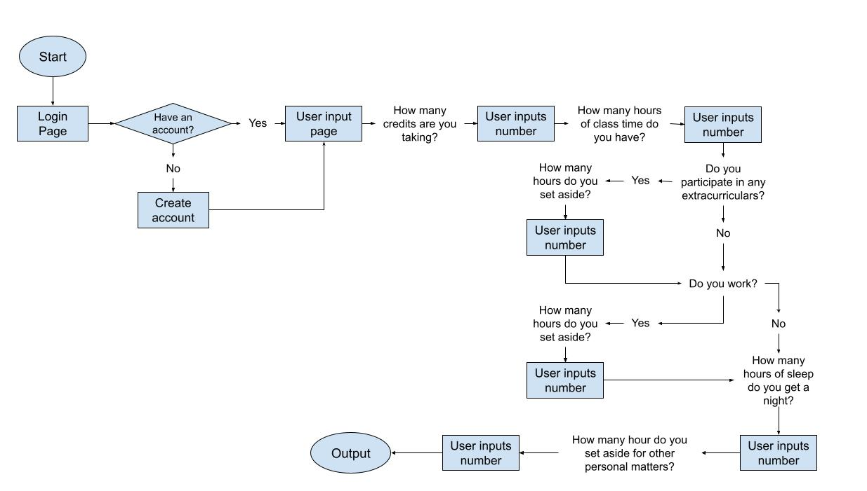
User Flow

Slide 4
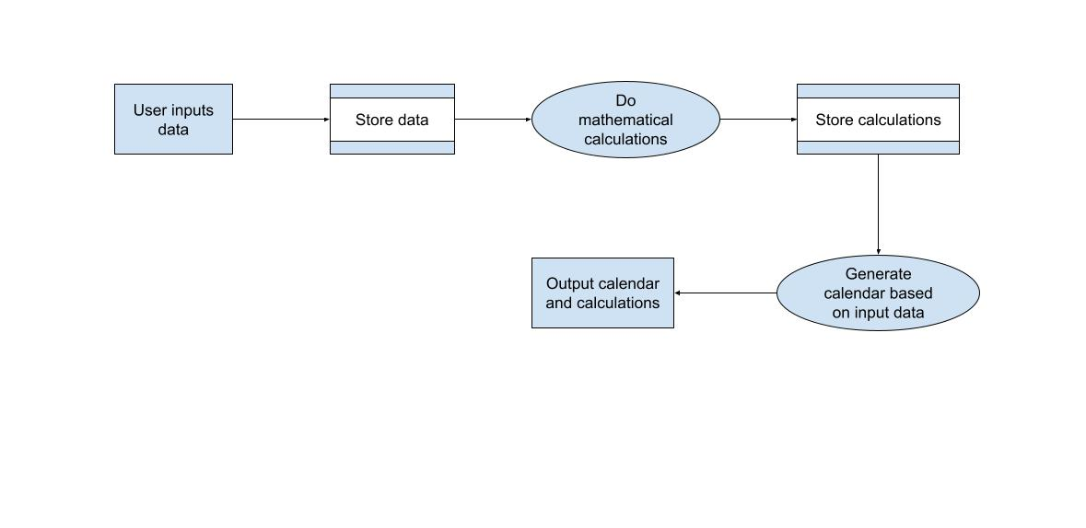
Data Flow Diagram of Application Logic
The user will input data mostly integers or doubles. They will be stored in a database. Then the data will be pulled from the database and some basic arithmetic calculations will be done. Those will then be stored. The program will then generate a study calendar based on the info provided and the calculation and then out put that calendar and the calculations.

Slide 5
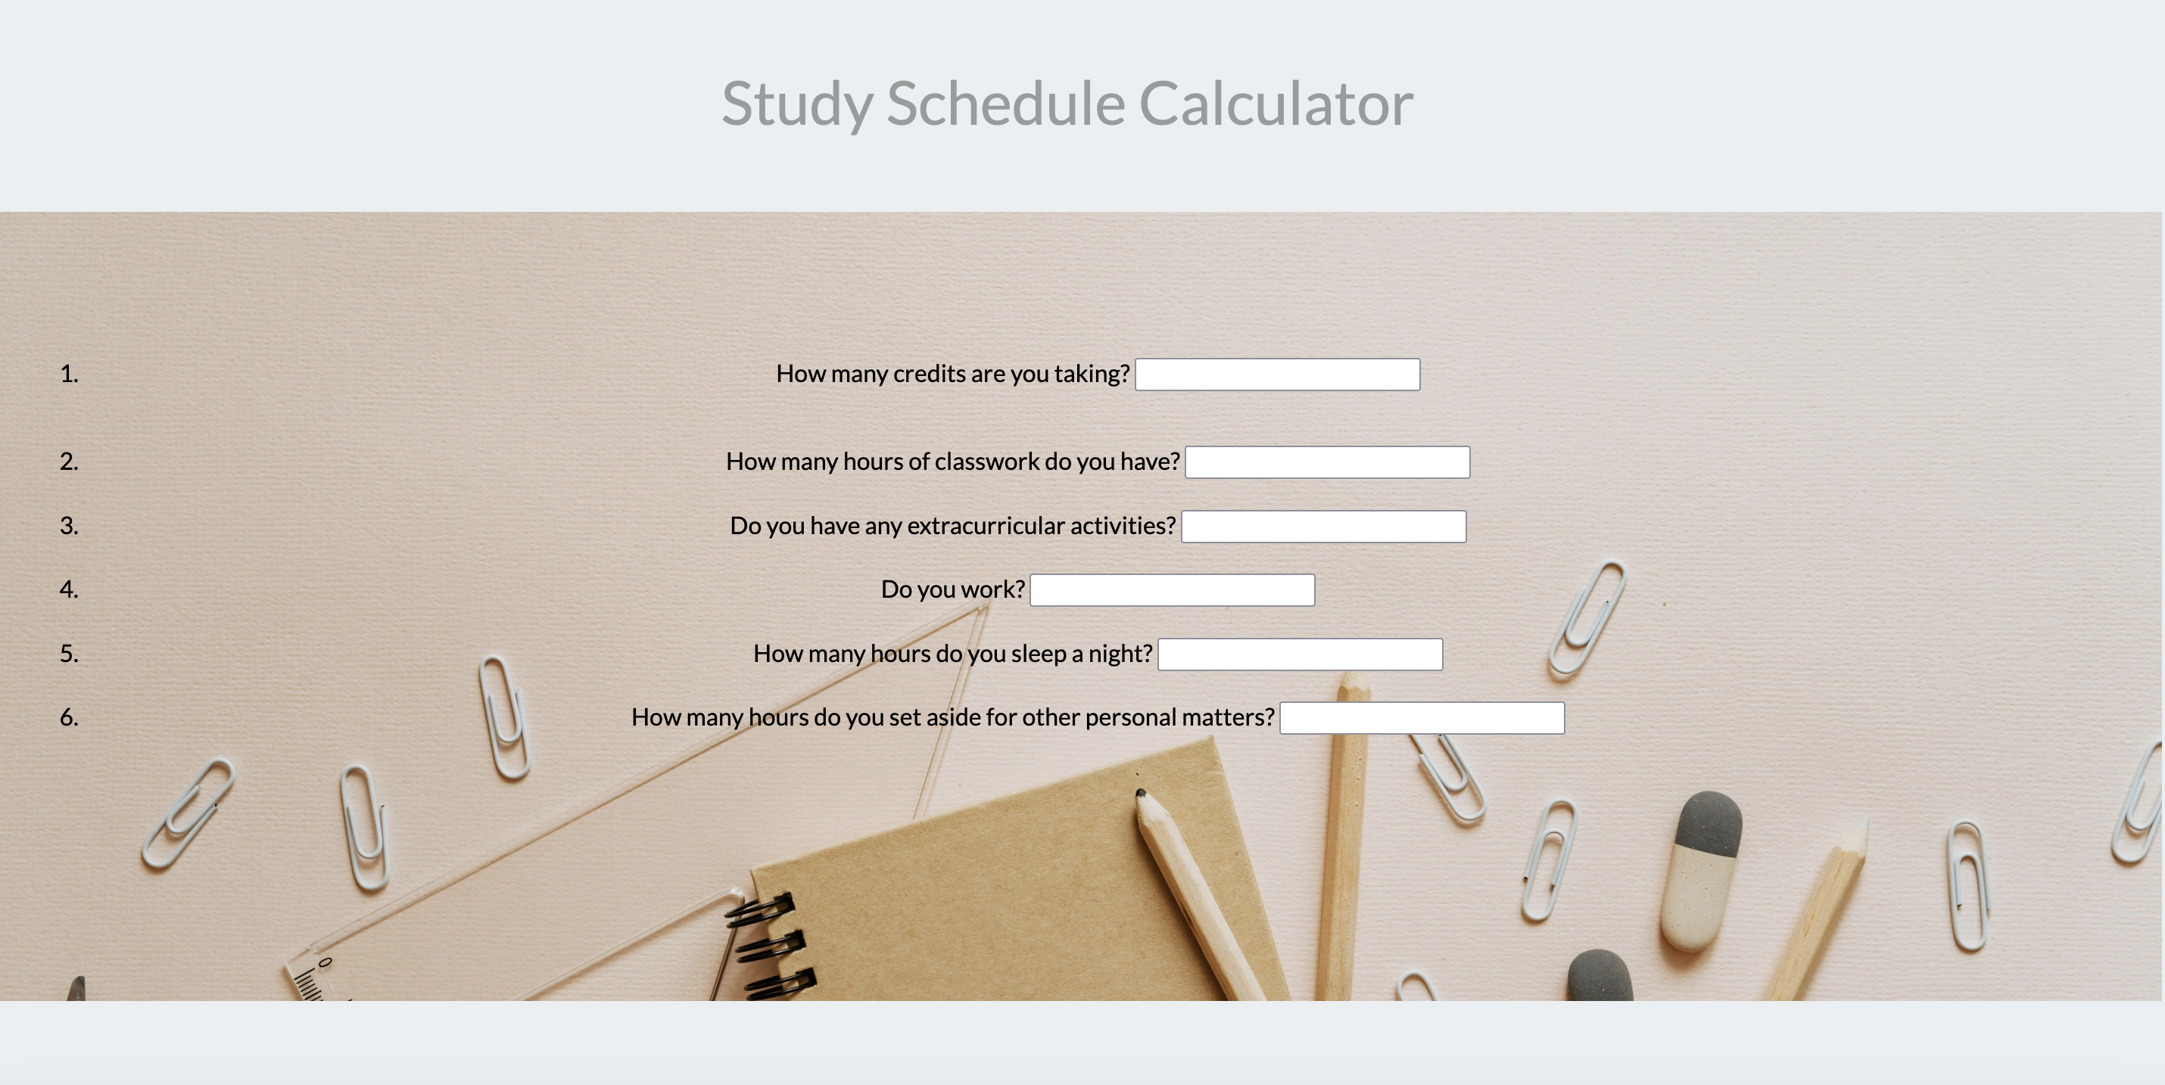
User Interface

Slide 6
Database Schema
Each class mode (synchronous, hybrid, asynchronous) will have a bunch of coursework sections that can be selected as applicable.
lecture (specifically for hybrid and asynchronous) – bool – whether or not they have a lecture they need to watch
quizzes - bool – whether or not they have a quiz coming up they need to study for
tests - bool – whether or not they have a test coming up they need to study for
assignments – separate list as there are a variety of them
projects – bool – whether or not they have a project coming up they need to do
study time per class – double – the amount of time needed to study per class
total study time - double - the total amount of time needed to study weekly
tutoring - double - the amount of time needed for tutoring
General
number of credits – int – the number of credits for the class
Assignments
reading – int – the number of pages for the assigned reading
discussion board – bool - whether or not they have a discussion board they need to do
essay – int – the number of pages they need to write
research paper – int – the number of pages they need to write
lab - bool - whether or not they have a lab they need to do
questions - bool - whether or not they have questions they need to answer
math equations - int – the number of equations they need to do

Slide 7
Tentative Schedule
Task | 1 | 2 | 3 | 4 | 5 | 6 | 7 | 8 | 9 | 10 | 11 | 12
Project planning, design, and logic
Make up paperwork (started project late)
Proof of concept
Write code for front end and user interface and test it
Write code for back end/database and test it
Connect to google calendar
Work on final presentation and slides
Work on other course requirements

Slide 8
Use Cases
A freshman student wants to test out possible schedule options and see how the different ones will work with their other obligations and if they will be able to manage their course load. The user must input the necessary data for each variation, and they will receive the different study schedules and calculations. This can help them figure out what schedule and courseload works best for them.
A student who works a job or has an internship wants to ensure that they will have enough time to complete all their schoolwork for that week. The user inputs the necessary data, and the system will output a study schedule if they have enough hours in their week. If not, the program will inform them that they do not have enough time in their week to accomplish everything they want to, and they will have to reprioritize.
A student wants to track the amount of time they spend studying and doing assignments for each class. The user will input the necessary data each week. They should receive the amount of time allocated for each class (using trackers). Additionally, they should be able to track their studying throughout the semester.

